Slide 1
BIG DATA
&
HADOOP
GUIDED BY : PROF. P. B. MALI SIR
PRESENTED BY : SUDARSHAN SHARAD GAWALE
( 176114 )

Slide 2
CONTENTS
WHAT IS BIG DATA ?
WHO GENERATES THIS BIG DATA?
INTRODUCTION TO HADOOP
WHY HADOOP IS IMPORTANT ?
HADOOP COMPONENTS , CLUSTER AND OPERATIONS
MAPREDUCE FRAMEWORK
PIG LATIN SCRIPT
PRACTICAL DEMONSTRATION
CONCLUSION

Slide 3
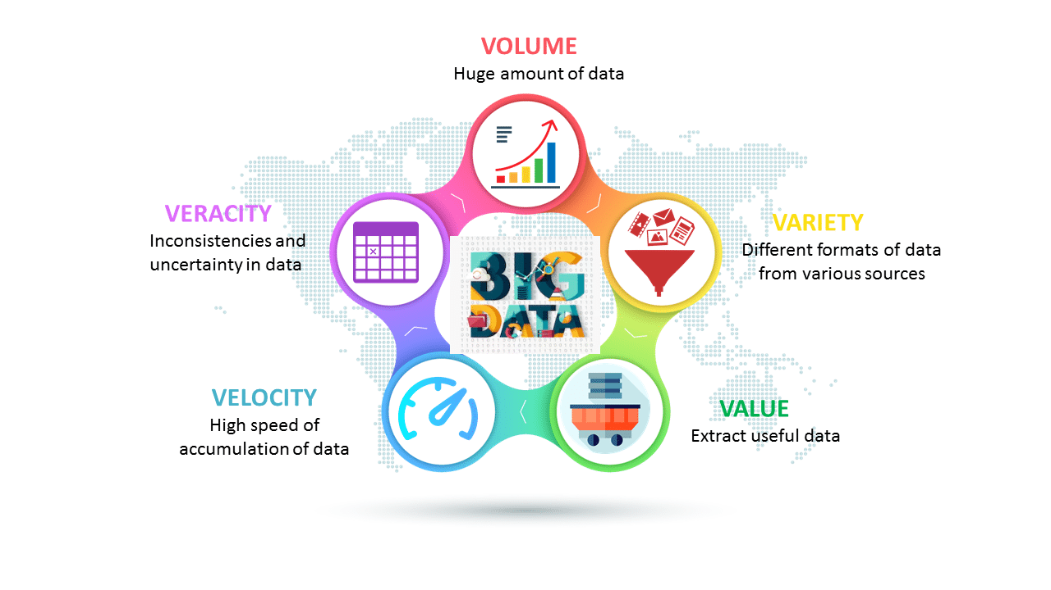
WHAT IS BIG DATA ?

Slide 4

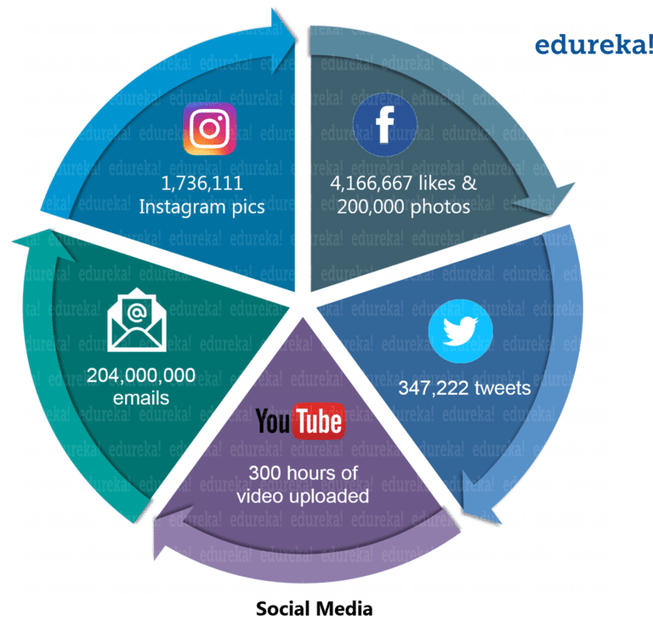
WHO GENERATES THIS BIG DATA?

Slide 5

HADOOP
Open source software framework designed for storage and processing of large scale data on clusters of commodity hardware
Created by Doug Cutting and Mike Carafella in 2005.
Cutting named the program after his son’s toy elephant.

Slide 6















WHY HADOOP IS IMPORTANT ?
WHO USES HADOOP ?

Slide 7
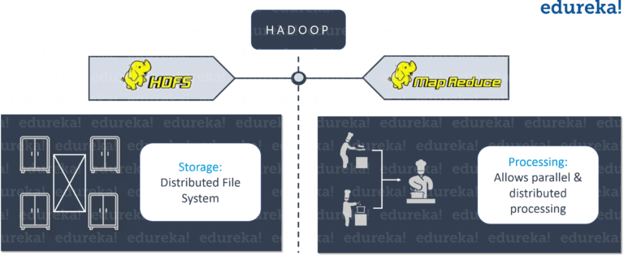
HADOOP COMPONENTS

Slide 8

HADOOP CLUSTER
NAMENODE
[ RESOURCE MANAGER ]
SECONDARY
NAMENODE
[ NODE MANAGER ]
DATANODES
FOLLOWS MASTER-SLAVE ARCHITECTURE

Slide 9
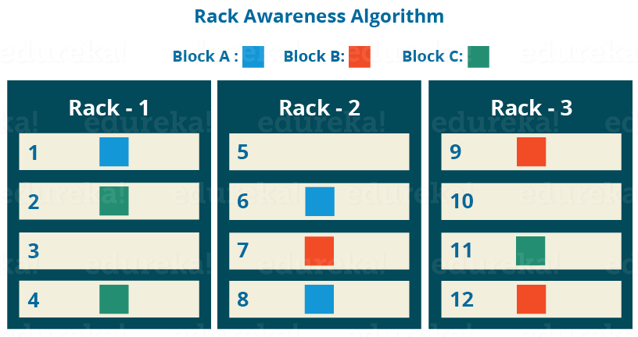
DATA REPLICATION
BY DEFAULT REPLICATION FACTOR IS 3 BUT IT IS CONFIGURABLE

Slide 10
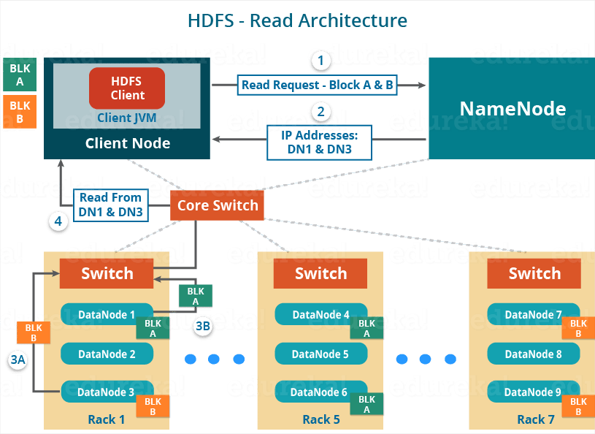
HADOOP READ OPRATION

Slide 11
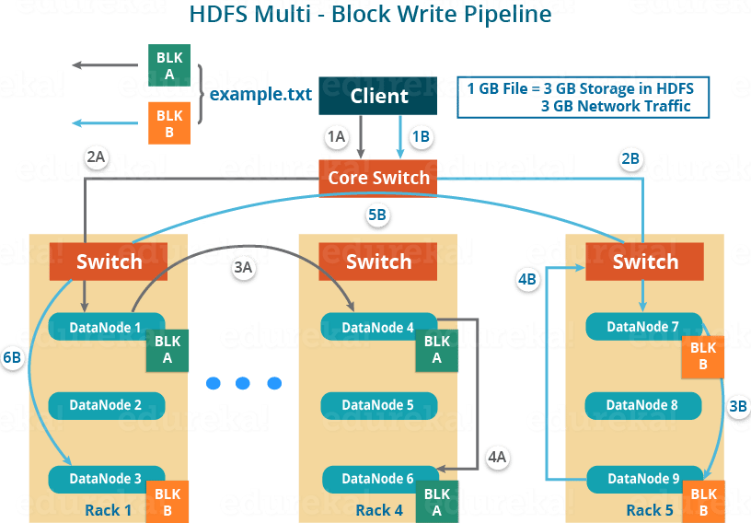
HADOOP WRITE OPERATION

Slide 12
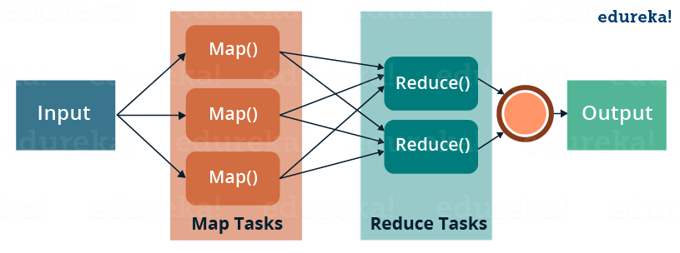
MAPREDUCE FRAMEWORK

Slide 13
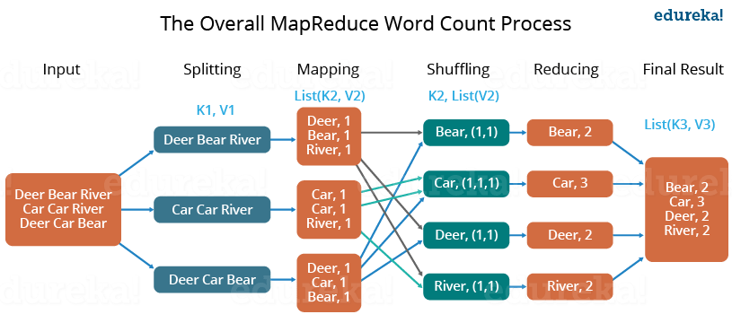
WORDCOUNT MAPREDUCE

Slide 14
PRACTICAL DEMONSTRATION OF HADOOP AND WORDCOUNT JAVA PROGRAM

Slide 15
BIG DATA ANALYSIS USING PIG LATIN
PIG LATIN SCRIPT
Developed at Yahoo.
Pig Latin is a high-level data flow language, whereas MapReduce is a low-level data processing paradigm.
Without writing complex Java implementations in MapReduce, programmers can achieve the same implementations very easily using Pig Latin.
Java to Pig Latin ratio 200 : 10
Used to anayze and mine big datasets.
Uses Grunt shell ( CLI )

Slide 16
PRACTICAL DEMONSTRATION OF ANALYZING OLYMPIC DATASET USING PIG LATIN

Slide 17
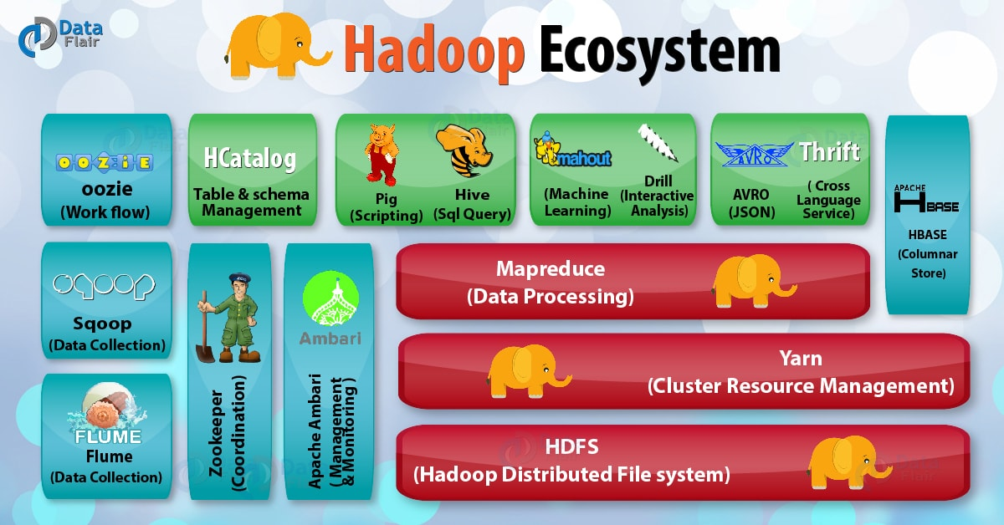
THE HADOOP ECOSYSTEM

Slide 18
CONCLUSION
Big Data is growing rapidly as never before.
Big data is important as orgnizations can mine meaningful insights from this big data for their business.
To cater this increasing demand of storage and computation frameworks like hadoop are essential.
Hadoop stores and processes big data efficiently and with faster execution time and also provides robust fault tolerence.

Slide 19
THANK YOU !

